Slide 1
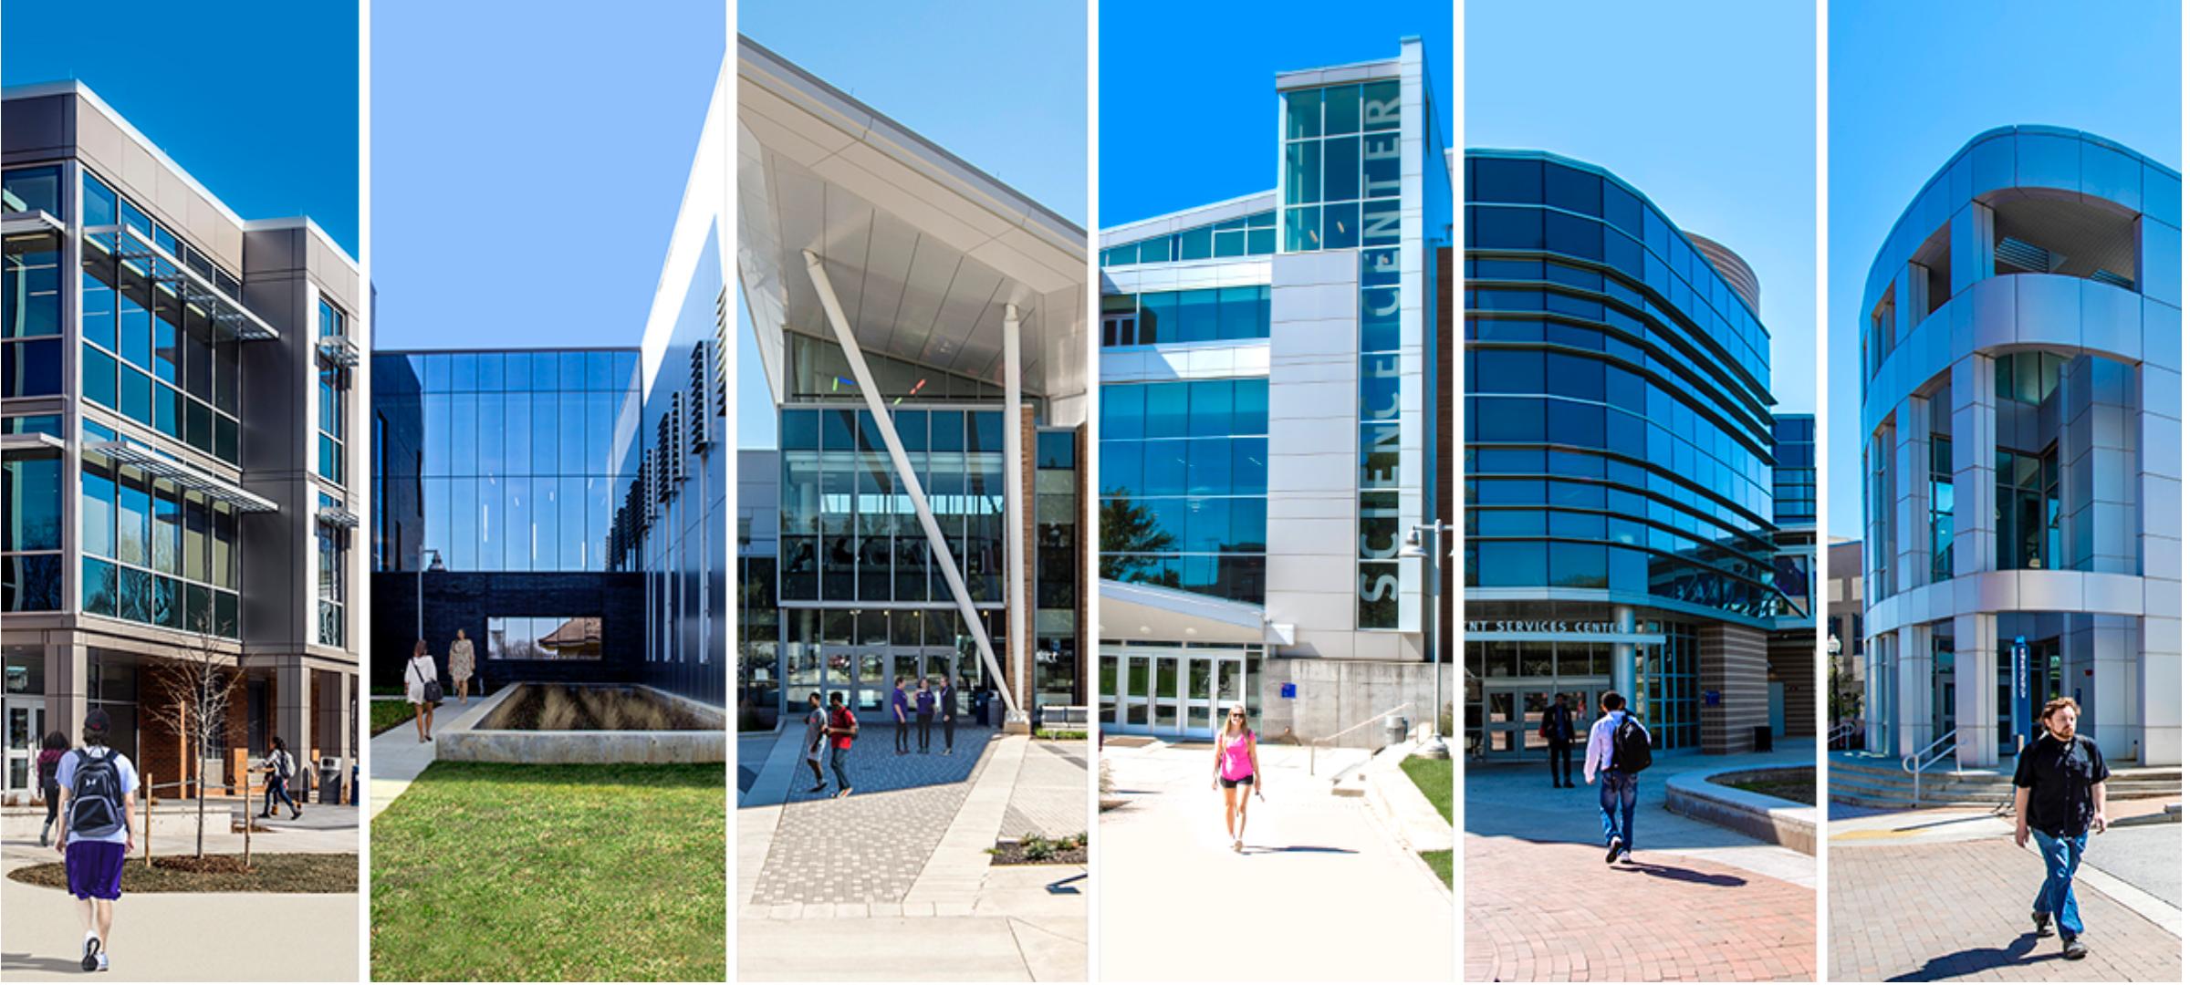


The Effect of the Pandemic on the Montgomery College Fall 2020. Freshman Cohort Emmeleen Ulita Gilbert

Slide 2
Introduction
Wanted to investigate the effect the pandemic had on the Fall 2020 Freshman Cohort
Students faced many new challenges e.g economic
Online learning presented new challenges and opportunities

Slide 3
Research Questions
Who’s here? Who’s not here?
Are some majors more popular or less popular?
Are students taking more or less courses?
Are students earning more or less credits?
How are students performing?
Are certain subgroups of the student population affected more than others?

Slide 4
The Data
Montgomery College Student Data
Source: Professor John Hamman, Chief Analytics and Insights Officer Montgomery College
List of High Schools in Montgomery County
Source: dataMontgomery

Slide 5
Terminology
Freshman Cohort: No prior tertiary Education. Start first degree in Fall Semester.
No prior college credits, may have AP credits from High School.
Term Year: The Fall 2020 cohort is classified as term year 2021.
The Fall 2019 cohort is classified as term year 2020.
Hours Attempted: Includes both credit and non-credit hours attempted.
Hours Earned: Credit hours earned. AP credits are reported in first semester.
Full time or Part time : Based on students intended enrollment as specified in admissions application form.

Slide 6
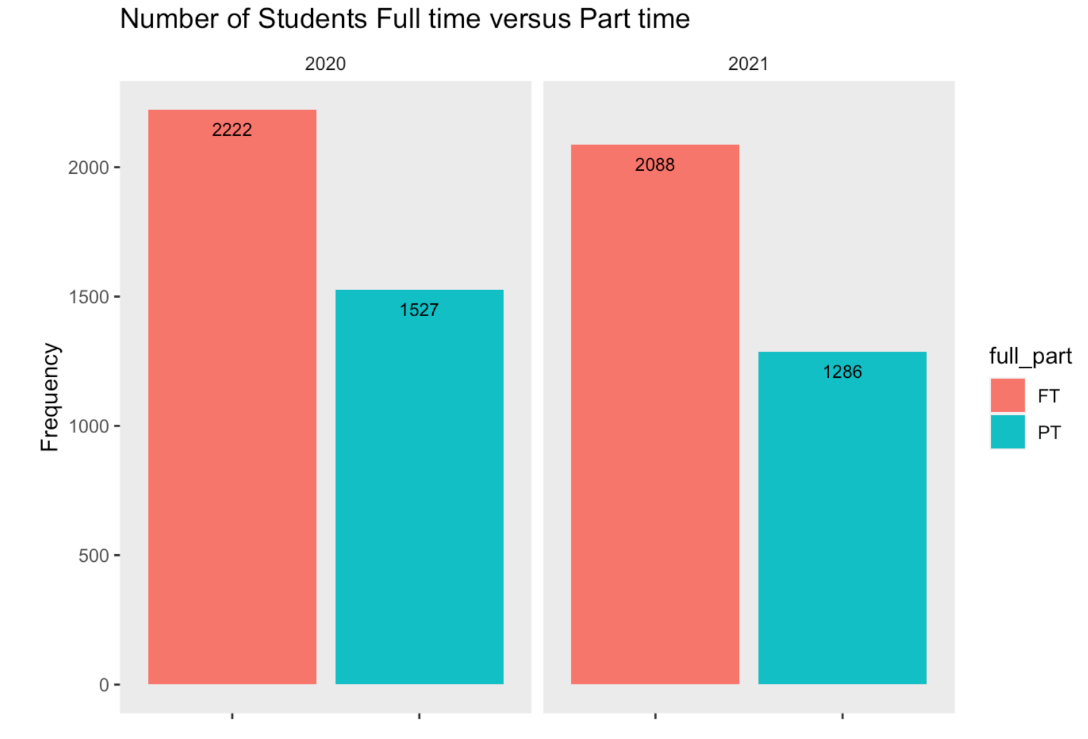
Who’s here? Who’s not here
8.7% decrease in cohort size
Full time enrollment down 6%
Part time enrollment down 15.8%
2/3 full time. 1/3 Part time

Slide 7
Who’s here? Who’s not here
Change in Full-time Enrollment
Asian Males -25%
African American Males -21%
White Males -11%
Foreign Males – 24%
Foreign Females: -13%
Hispanic females + 18%
Hispanic Males +3%
Decrease in Male Students
Decrease in Foreign Students
Increase in Hispanic Students

Slide 8
Who’s here? Who’s not here
Change in Part-time Enrollment
Foreign Males -40%
Foreign Females -40%
Asian females -40%
African American Males -20%
Hispanic Males -25%
Hispanic females – 12%
White males 21%
Decrease in Foreign Students
Decrease in Asian Females
Decrease African American Males
Decrease in Hispanic Students
Increase White males

Slide 9
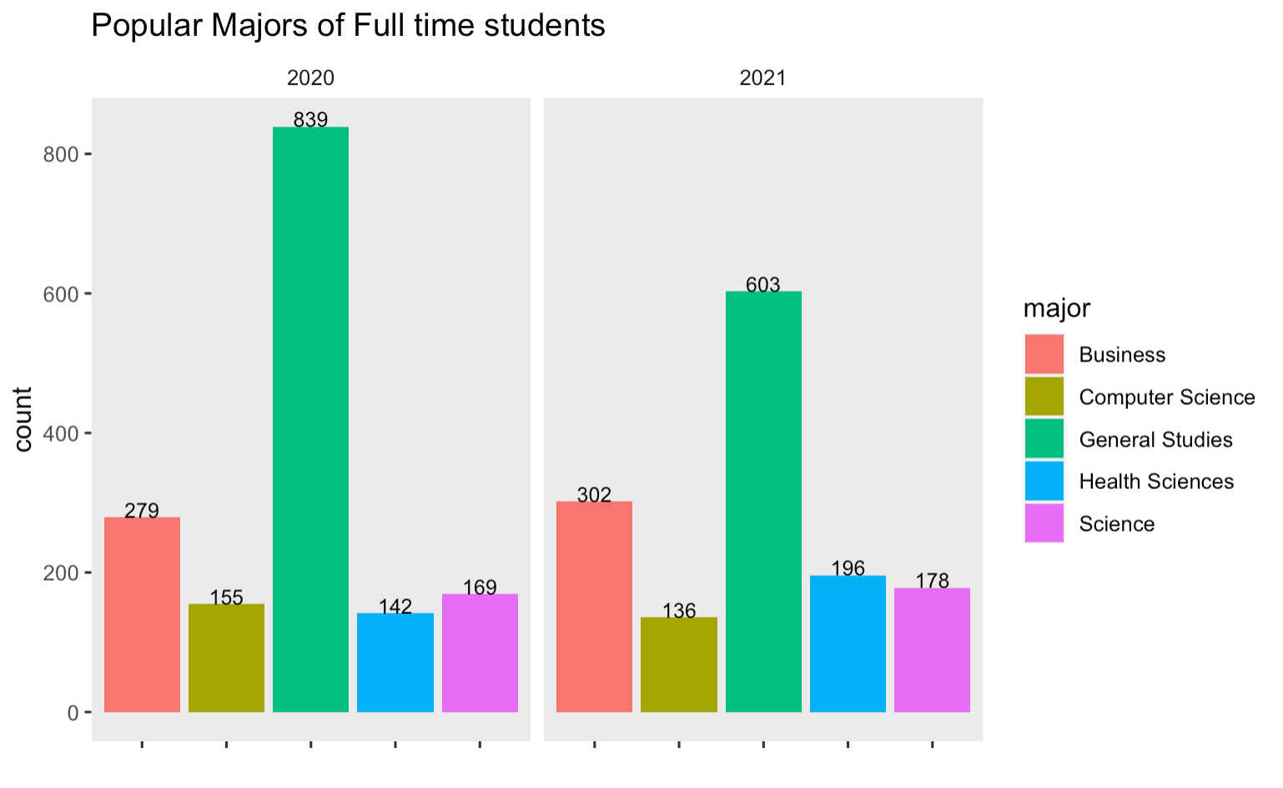
Are some courses more popular?
5 most popular majors 71% registration in 2020
5 most popular majors 68% registration in 2021
General Studies -28%
Health Science +38%
Business +8.2%
Hispanic Student registration in Health Science as doubled

Slide 10
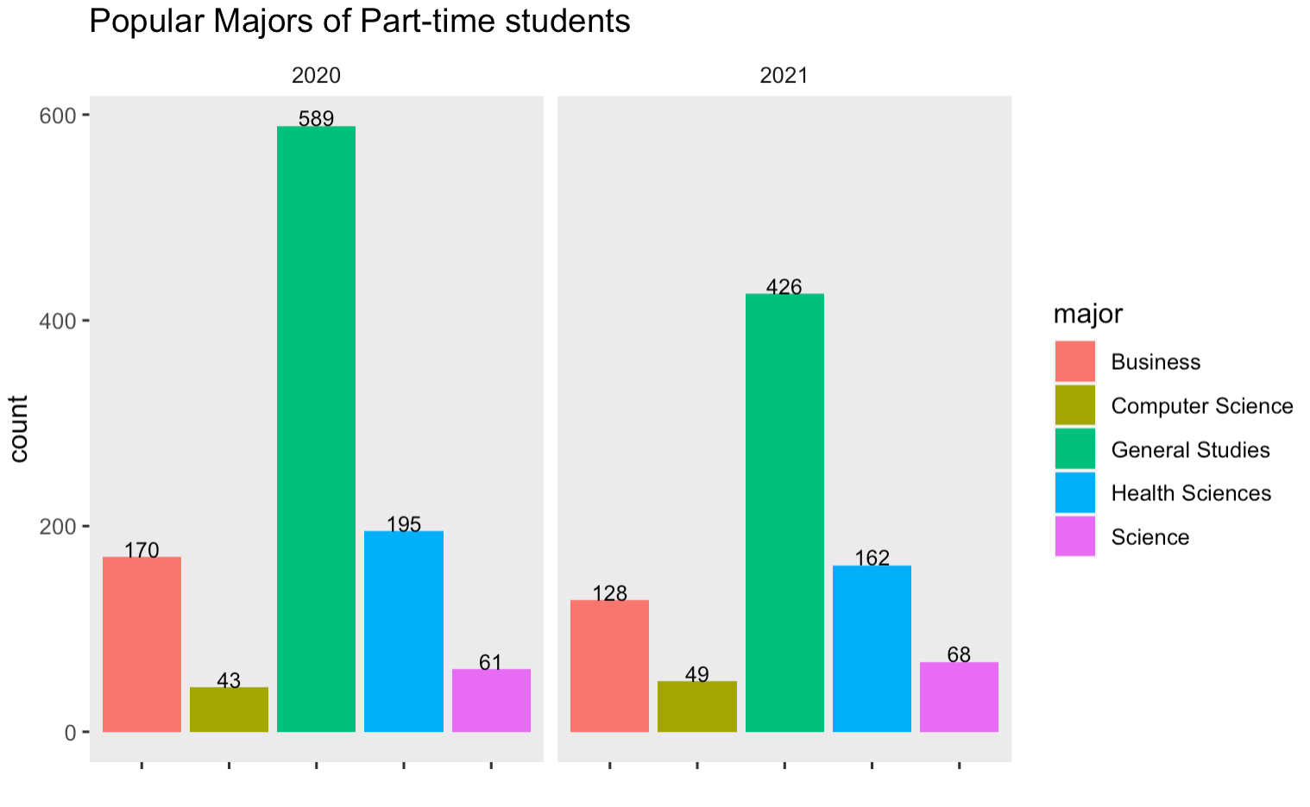
Are some courses more popular?
5 most popular majors 69 % registration in 2020
5 most popular majors 65% registration in 2021
General Studies -28%
Health Science -17%
Business -25%
In 2020 more part time health majors than full-time
In 2021 more full time health majors than part-time

Slide 11
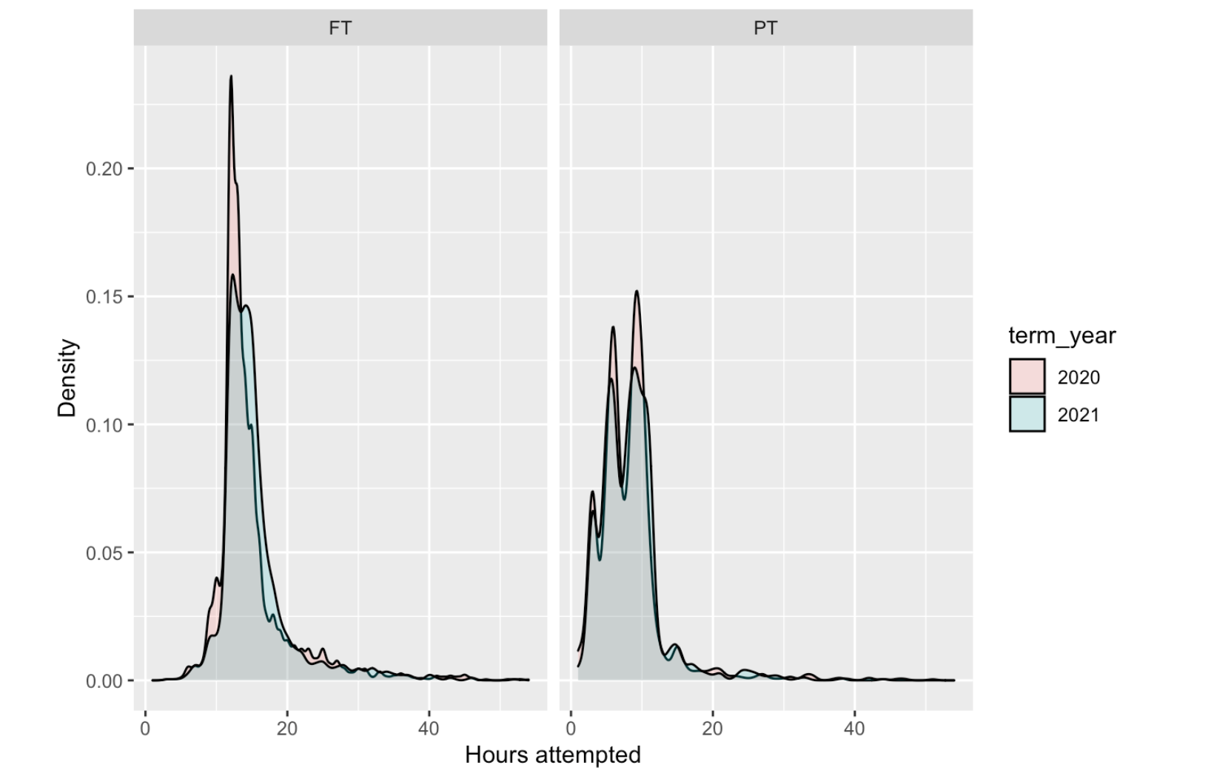
Are students attempting more or less hours?
Full time students attempting about 1hr more
Part time students no difference

Slide 12
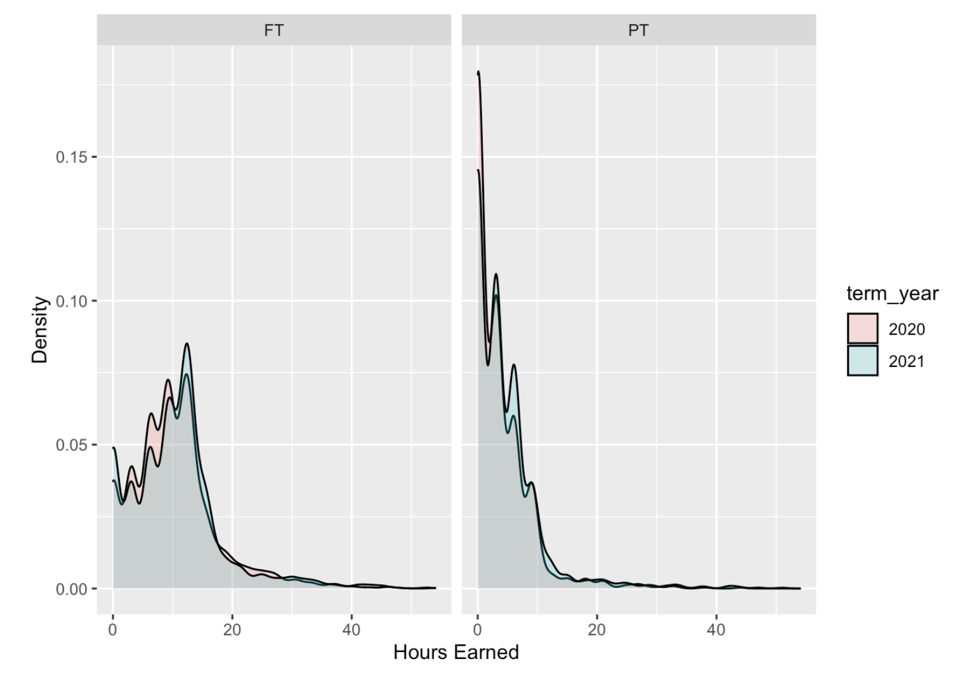
Are students earning more or less hours?
Full time not much difference.
(median is 1hr higher)
Part time students no difference

Slide 13
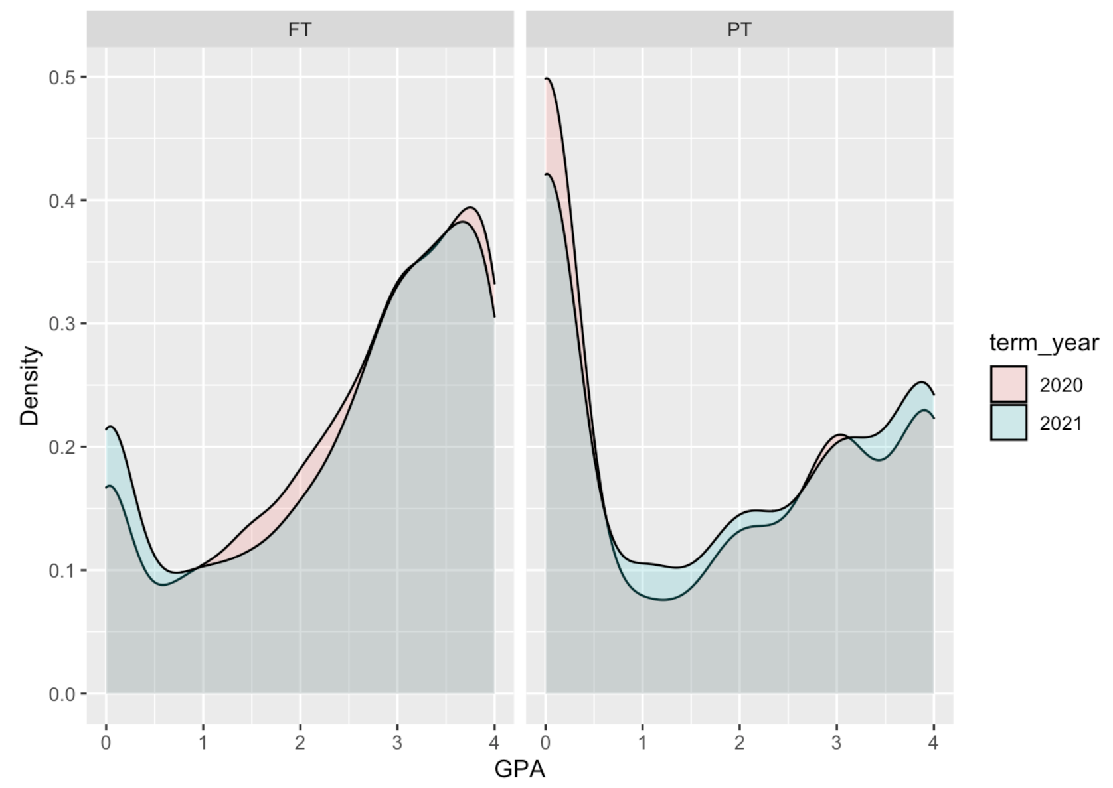
How are students performing?
Full time time students slightly worse
3.1% decrease in students in good standing
Part time student performing better
3.1% increase in students in good standing

Slide 14
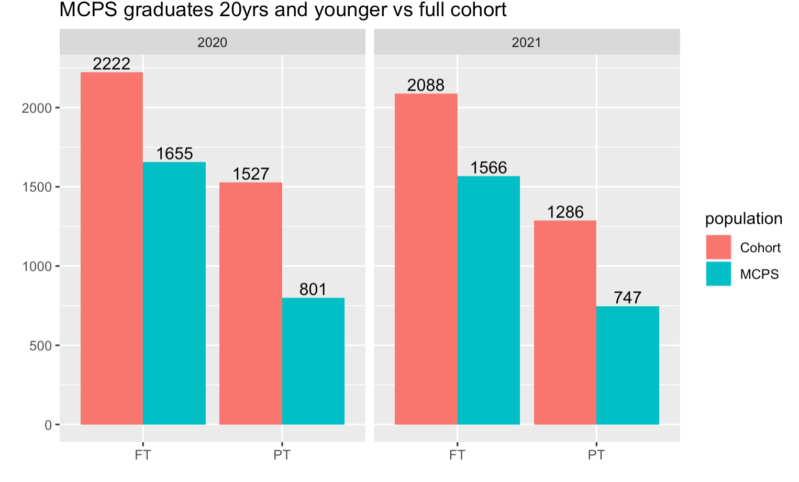
Students who graduated from MCPS High Schools who are 20yrs and younger
Are some subgroups affected more than others?
74.5%
52. 5%
75%
58%

Slide 15
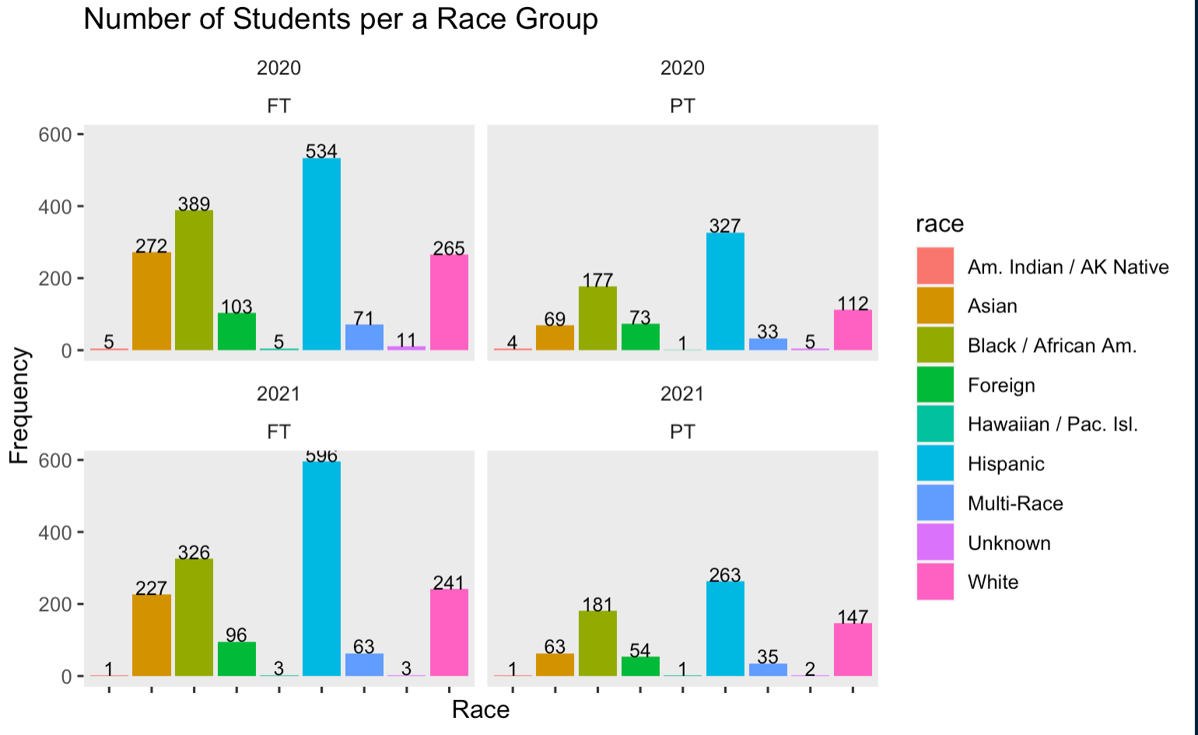
Students who graduated from MCPS, aged 20yrs and younger
 | Change in Full-time enrollment | Change in Part-time enrollment
Hispanic | 11.6% | -19.6%
White | -9.1% | +31.3%
African American | -16.1% | + 2.6%
Asian | -16.5% | -8.7%

Slide 16
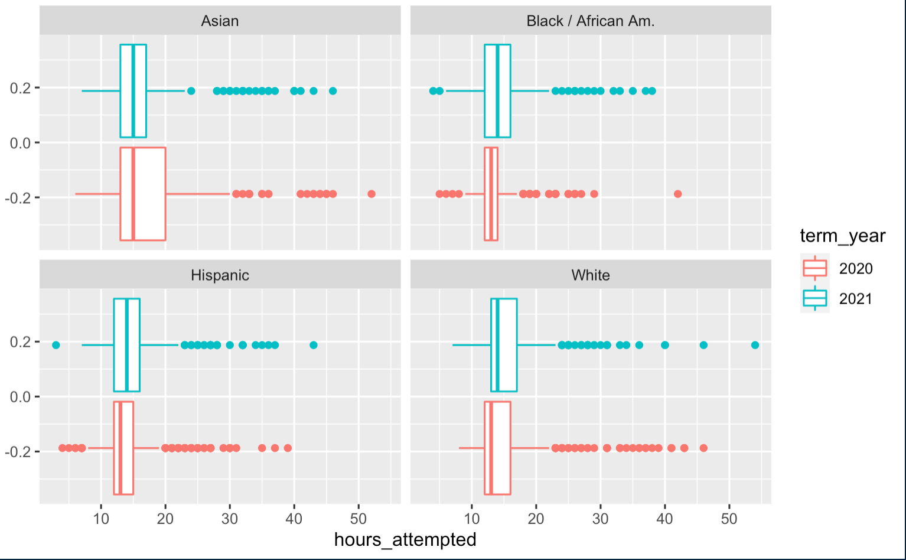
MCPS graduates: Full-time Students
Asian: Attempting slightly less hours (Q3 lower)
African American : Attempting more hours (median higher than previous years Q3)
Hispanic: Attempting more hours (median and Q3 higher)
White: Attempting more hours (Q1, median and Q3 higher)

Slide 17
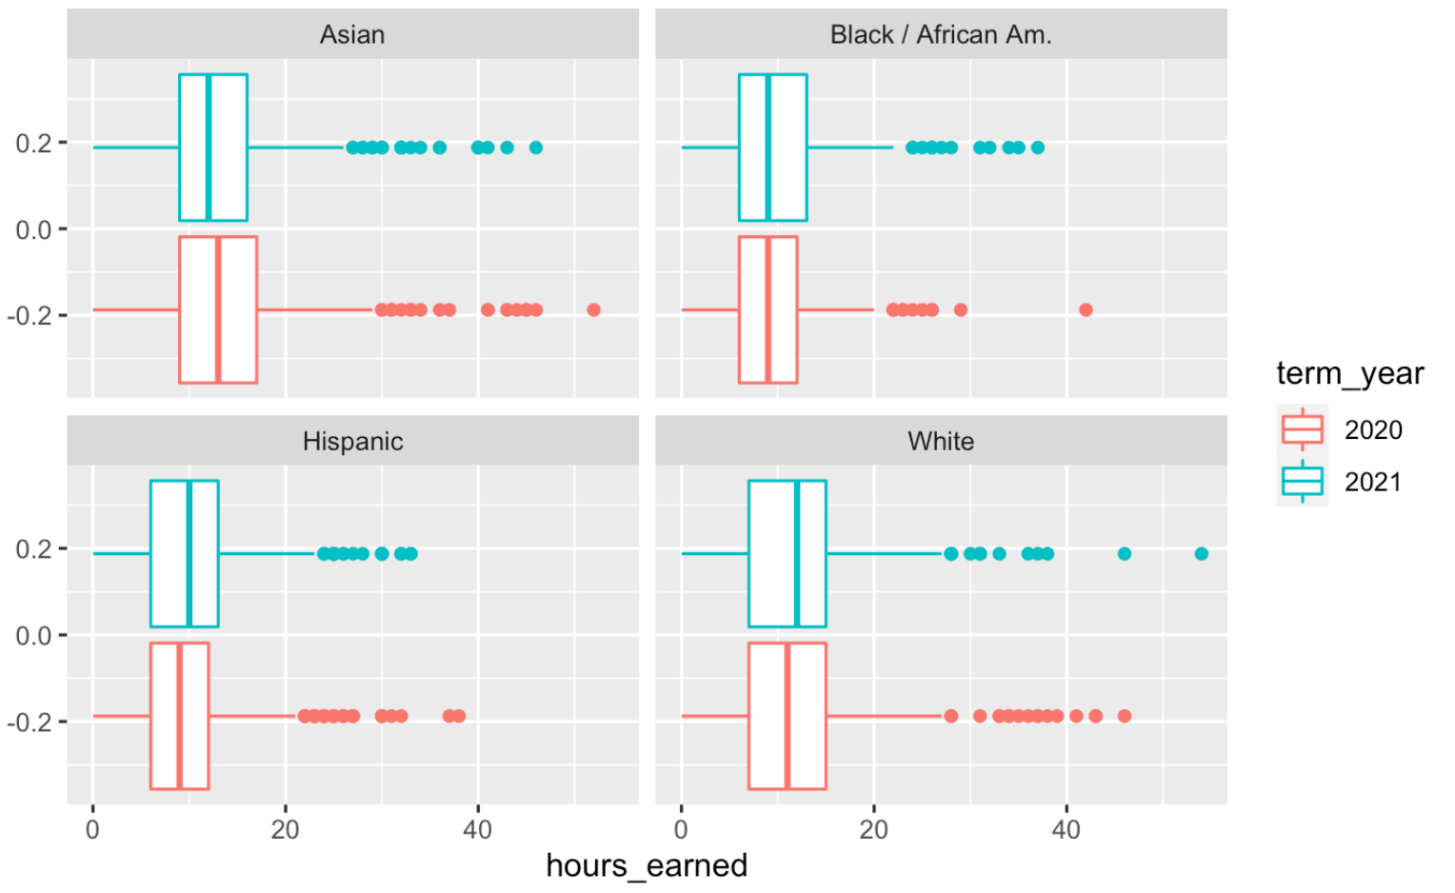
MCPS graduates: Full-time Students
Asian: Earning less hours.
(lower median and Q3)
African American : Earning slightly more hours (Q3 higher)
Hispanic: Earning more hours (median and Q3 higher)
White: Earning more hours ( higher median)

Slide 18
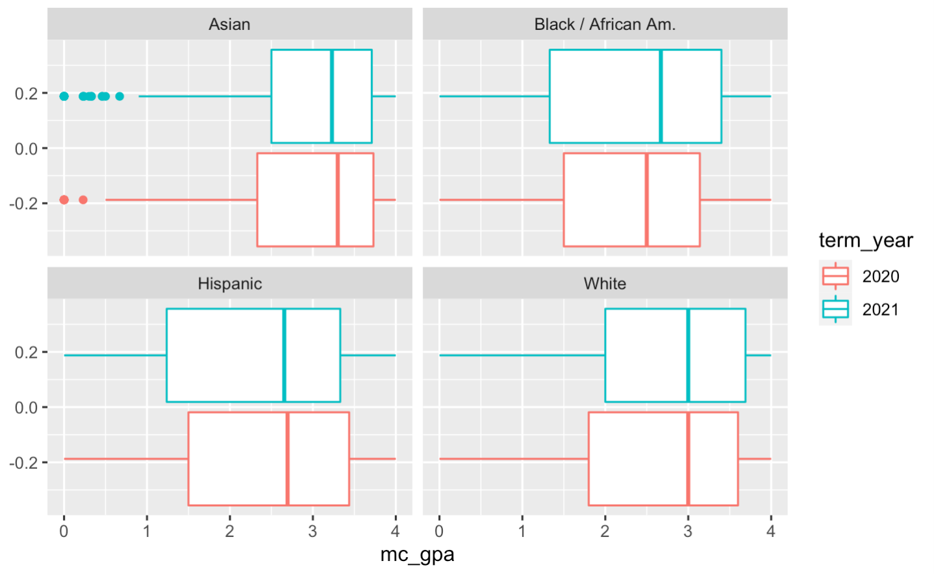
MCPS graduates: Full time Students
Asian:
2.75% decline in students in good standing (GPA>=2)
African American
Improvement in GPA (higher median and higher Q3)
2% drop in students in Good standing (GPA >=2)
Hispanic
Slight drop in GPA ( lower Q1 and Q3)
Percentage of students in good standing did not change
White:
Slight improvement in GPA ( Q1 and Q3 higher)
2.3 % increase in students in Good standing (GPA >=2)

Slide 19
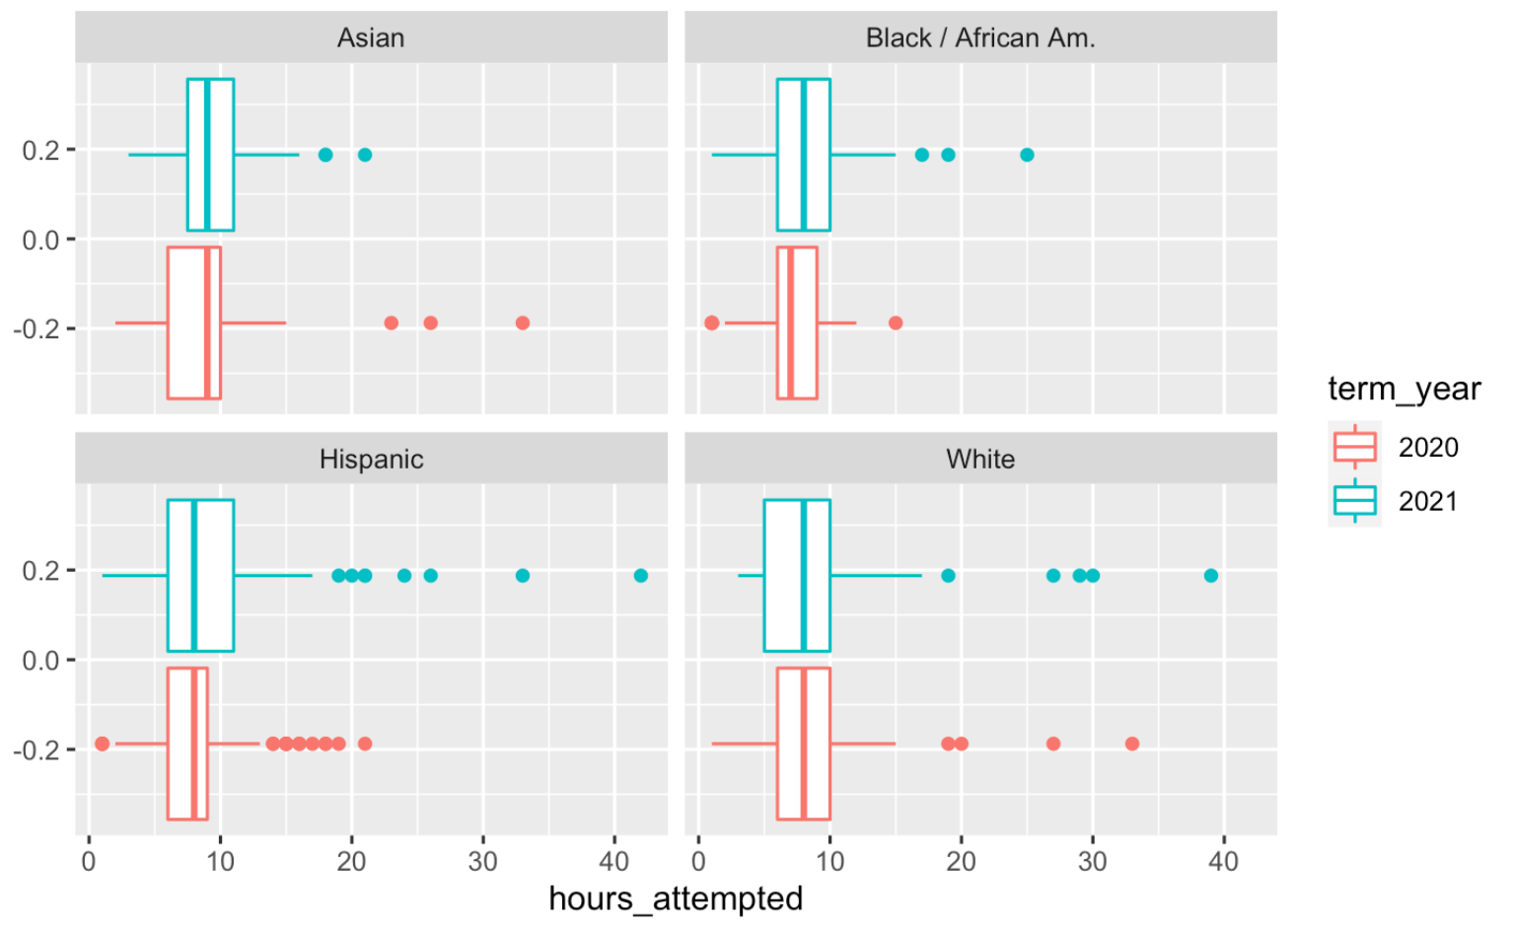
MCPS graduates: Part-time Students
Asian: Attempting more hours (higher Q1 & Q3)
African American : Attempting more hours (median and Q3 higher)
Hispanic: Attempting more hours (Q3 higher)
White: Attempting slightly less hours (lower Q1)
*30% increase in enrollment. Difference in behavior in these students.

Slide 20
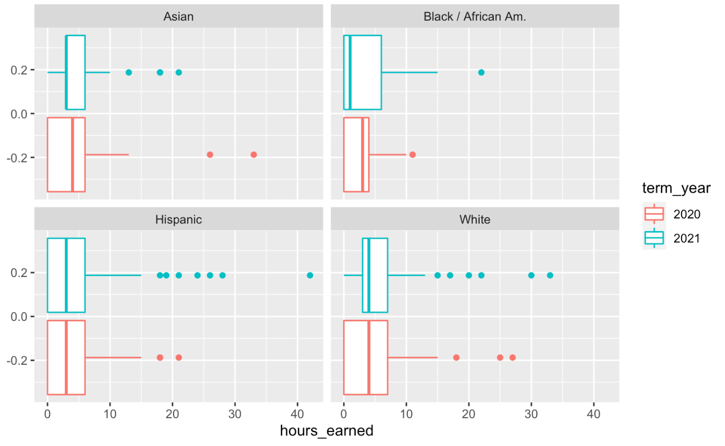
MCPS graduates: Part-time Students
Asian Earning slightly more hours (Q1 higher but median lower)
African American : Earning slightly fewer hours (median lower, Q3 higher**)
Hispanic: Earned the same number of hours
White: Earning slightly more hours (Q1 higher)

Slide 21
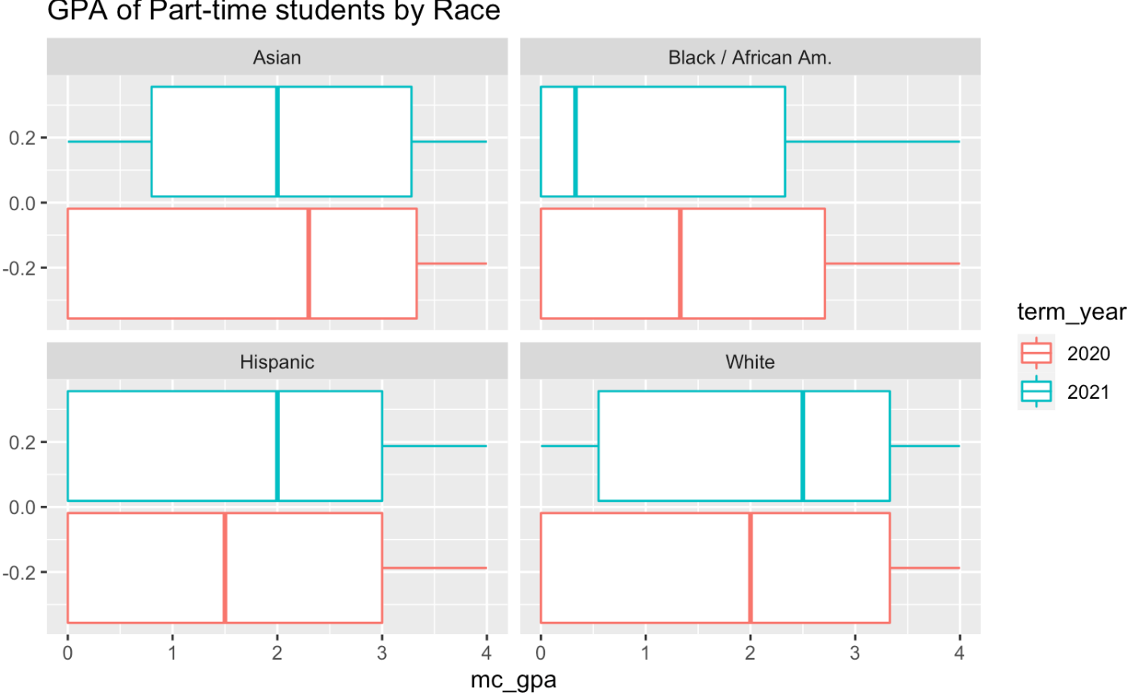
MCPS graduates: Part-time Students
Asian:
Drop in GPA (lower median - fell below 2)
12% decline in students in good standing (GPA>=2)
African American
Lower GPA (lower median -75% drop, lower Q3)
9.82 % decline in students in good standing (GPA>=2)
Hispanic
Performing better (higher median)
3.55 % increase in students in good standing (GPA>=2)
White:
Improvement in GPA (Median and Q1 higher)
6.9 % increase in students in Good standing (GPA >=2)

Slide 22
MCPS Students : Summary
Part-time students have been affected more than full-time students.
Full-time students:
Asian students negatively impacted
African American, White and Hispanic students performing better.
(attempting more hours, earning more hours, GPA median same/ higher).
Part-time students:
Asian and African students negatively impacted (earning less hours, lower GPAs)
Hispanic and White students performing better (earning more hours, higher GPAs)

Slide 23
Acknowledgements
Professor Michael Iapalucci
Professor John Hamman
Professor Rachel Saidi
Professor Abdirisak Mohamed

